Slide 1

AN INTRODUCTION TO QLDC’S ‘PROJECT H’ – DELIVERING SPATIAL COLLABORATION
QLDC FORWARD WORKS PIPELINE
23rd October 2019
Paul Haggath
Natasha Brooks

Slide 2
LTP: QLDC’s CAPITAL WORKS PROGRAMME 2018-2027
QLDC - $1b in next 10 years
Same again for private developments

Slide 3
QUEENSTOWN PROJECTS
3 Waters
Transport
Way To Go
Town Masterplans
Ops & Maintenance
Parks & Reserves
Private
Hotels
Commercial
Skyline
Events
Subdivisions
Notes:
Animate!

Slide 4






Slide 5
PROJECT H
Project H provides a visual GIS based tool that captures project data of QLDC projects and third parties, to inform and assist in strategic planning, traffic management, RMA planning and approvals.

Slide 6
PROJECT H
Its adoption by both QLDC and external users will help to identify opportunities to collaborate between projects and developers and drive decisions which minimise disruption to residents and visitors.

Slide 7
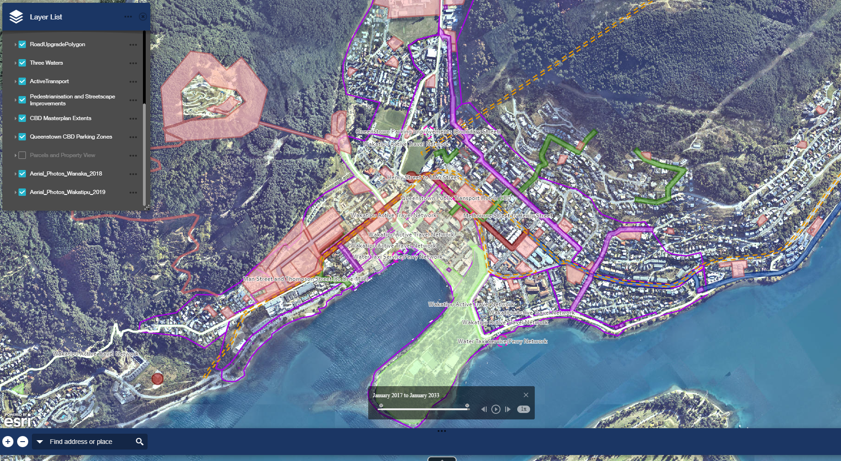
QLDC PLATFORM
http://qldc.maps.arcgis.com/home/item.html?id=920cc4f98c3f499dab77562e78923635
Notes:
Talk to
– 2 different platforms being utilised; this being internal facing GIS; the other is Forward Works Viewer
Different layers provided for different types of projects, e.g. Three Waters, Transportation, Private Developers etc.
Different key utilised for whether a project is in Early Planning, Planning and Development or Construction stages
Ability to focus in on a particular time

Slide 8
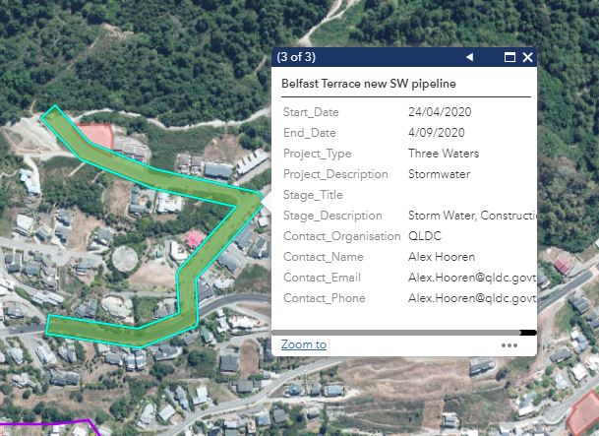
QLDC PLATFORM
Notes:
Talk to:
- The attribute box for each project; includes, project details, dates and key contact to enable collaboration when appropriate

Slide 9


Slide 10
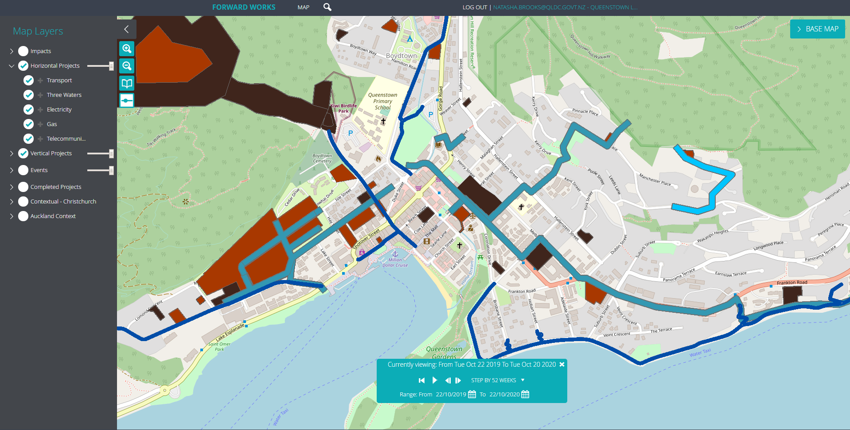
FORWARD WORKS
https://www.forwardworks.co.nz/#/map

Slide 11
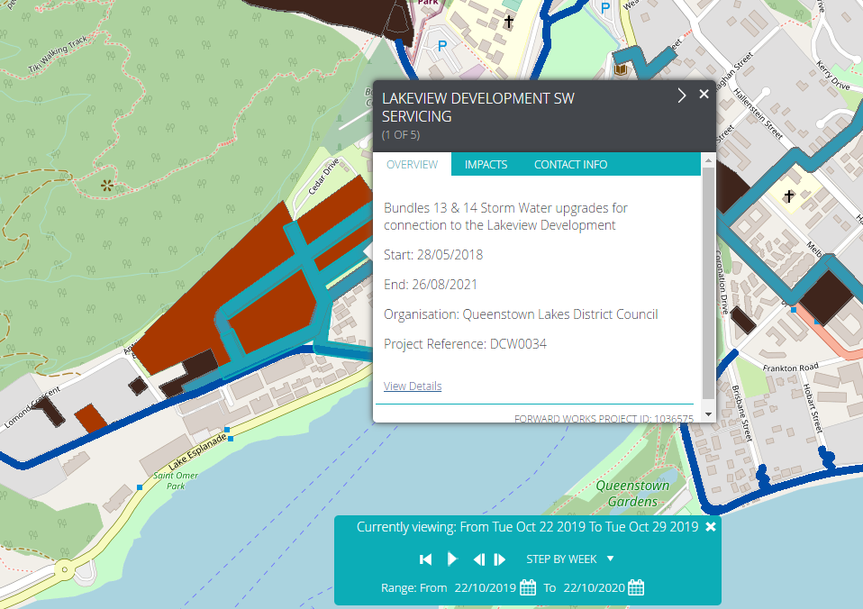
FORWARD WORKS

Slide 12
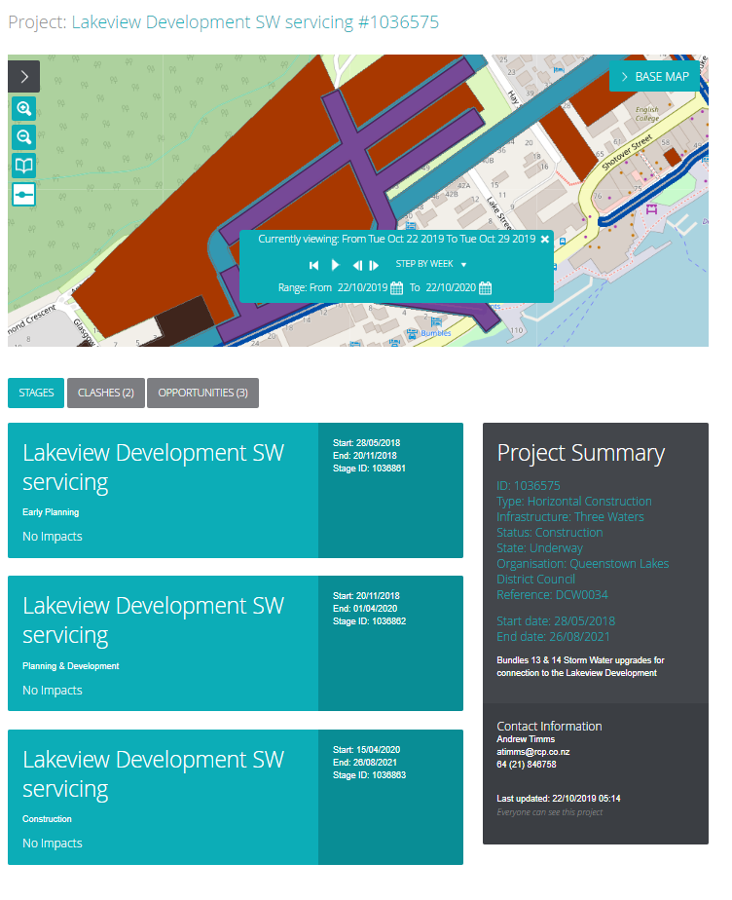

Slide 13
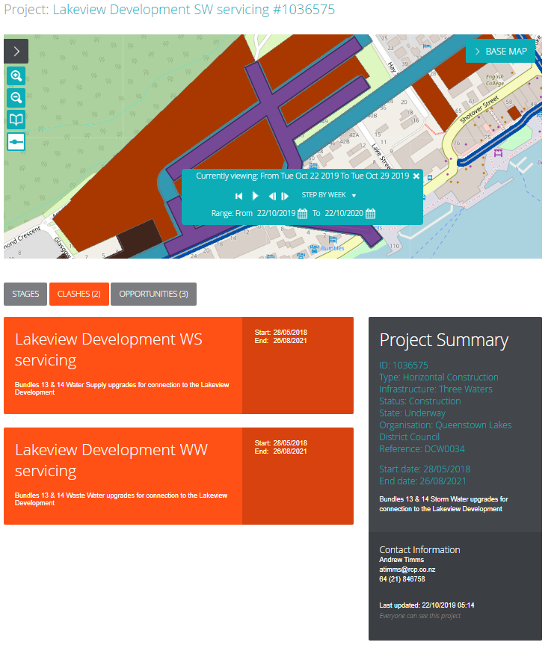

Slide 14
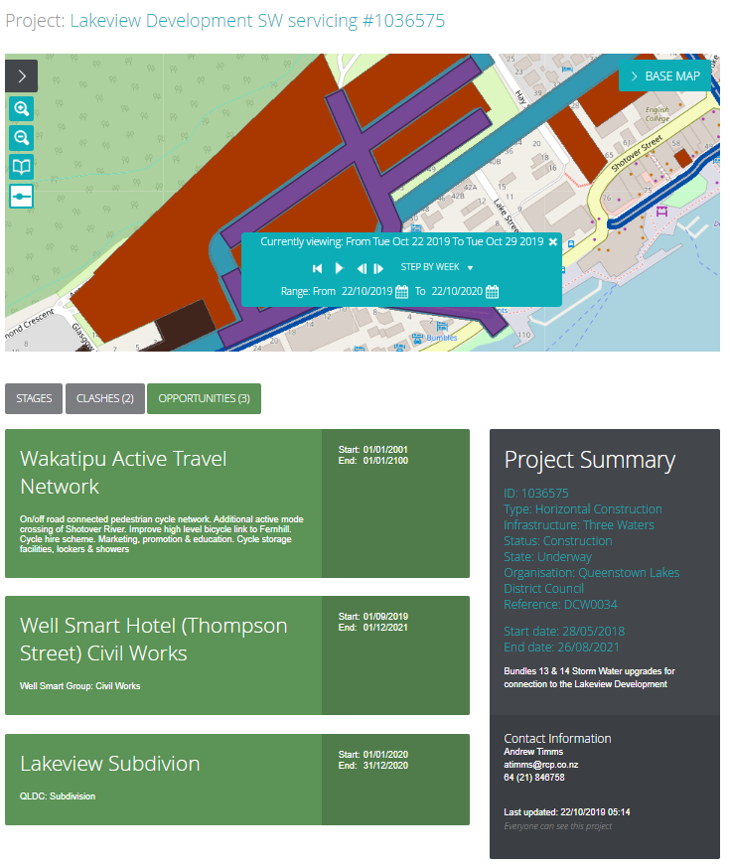

Slide 15
USES AND BENEFITS
Inform and assist strategic planning
Facilitate enhanced visibility of projects
Inform and assist Traffic Management
Inform and assist Resource Consent
Identify opportunities to collaborate
Enable co-ordination of interfacing projects
Drive decisions that minimise disruption
Overview of projected timeframes effects and wider environment

Slide 16
ENCOURAGING CONTRIBUTORS
QLDC BAU – will provide information as a matter of course
Third parties – may need some encouragement until they see the benefits

Slide 17
QLDC FORWARD WORKS FLOWCHART
Resource Consent condition or Traffic Management check
New project (private/ third party)
QLDC Project H advocate inc. RMA requirements
All contributors, Public access, O&M contractors,
Utilities
Update reminders (3 monthly?)
Forward Works (digitise and publish)
Public data
QLDC Master Spreadsheet
export
New project (QLDC)
Proc. manual
Project H administrator/ gatekeeper
Confide-ntial data
QLDC GIS platform
Master Schedule
QLDC GIS to digitise
API conversion
3 monthly updates (QLDC)
Traffic mgt, Planning,
SAP,
PMO,
O&M,
Consents team
Inputs
Resource requirements
Outcomes gained
Users
Notes:
To consider: API of RAMM to GIS
Different lines for projects / works that don’t go through RM process
Different lines not leading to orange outcomes for whether condition is required in RM process

Slide 18
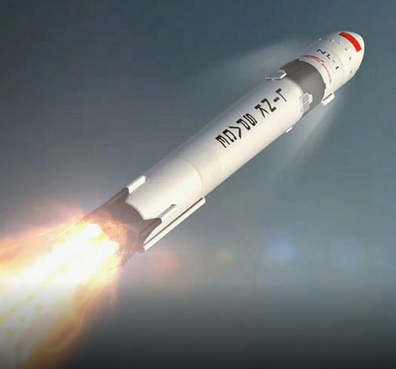
LAUNCHING SOON
Forward Works

